Slide 1
RevPay
Digital Payment Platform
A full-stack fintech application for seamless money transfers,
business invoicing, and loan management
Spring Boot 4
Angular 21
MySQL
JWT Auth
Java 21

Slide 2
Problem Statement
Problem 1
Problem 2
Cash is Inconvenient
Manual Business Billing
Sending money requires physical presence or slow bank transfers with delays of 1–3 business days.
Small businesses send invoices via email/WhatsApp with no tracking, no payment integration, and no records.
Problem 3
Problem 4
Opaque Loan Processes
No Unified Platform
Business loans involve paper applications, manual EMI tracking, and no transparency on repayment schedules.
Personal users, businesses, and admins need separate tools. No single system manages all financial operations.

Slide 3
What is RevPay?
RevPay is a full-stack digital payment platform that brings personal users, businesses, and admins under one unified system.
👤 Personal Users
🏢 Business Users
🛡️ Admin
Send & receive money instantly
Top-up wallet via saved cards
Request money from others
Full transaction history + PDF export
Create & send invoices
Apply for business loans
Track EMI schedules
Auto-debit EMI payments
Manage all user accounts
Approve / reject loans
Enable / disable accounts
Platform-wide oversight

Slide 4
Technology Stack
FRONTEND
BACKEND
Angular 21
Spring Boot 4
Standalone components, Signals, Lazy loading, Route Guards, HTTP Interceptors
REST APIs, Spring Security, @Transactional, @Scheduled jobs, GlobalExceptionHandler
LANGUAGE
DATABASE
Java 21 / TypeScript
MySQL
Type-safe backend + frontend. Generics, Streams, records on backend
Relational DB, Foreign keys, JPA/Hibernate ORM, Spring Data repositories
AUTH
PDF EXPORT
JWT + BCrypt
jsPDF (frontend)
Stateless tokens (24hr expiry), BCrypt password hashing (cost factor 10)
Browser-side PDF generation, no server needed, custom dark theme

Slide 5
System Architecture
FRONTEND
BACKEND
DATABASE
Angular 21
Spring Boot 4
MySQL
Components / Templates
Services (API calls)
Route Guards
HTTP Interceptor
Signals (state)
LocalStorage (JWT)
@RestControllers
@Service layer
@Repository (JPA)
Spring Security
JWT Auth Filter
@Scheduled Jobs
users
accounts
transactions
loans + emis
invoices
payment_methods
HTTP
REST API
JPA /
Hibernate
Security: JWT Bearer Token added to every API request via HTTP Interceptor. Spring JwtAuthFilter validates on every call.

Slide 6
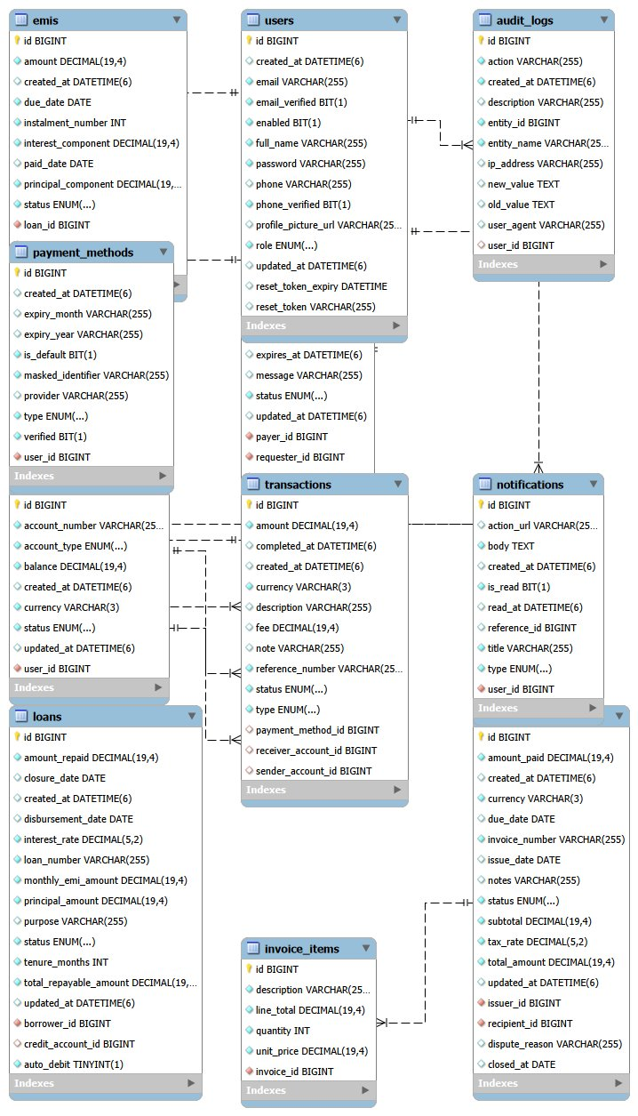
Database Design — ER Diagram
users
Auth, roles, reset tokens
accounts
Balance, account number, type
transactions
All money movements, credit/debit
loans
Business loan applications
emis
Monthly repayment schedule
invoices
Business billing records
payment_methods
Saved cards/banks (masked)
audit_logs
Action tracking for admin
notifications
In-app user notifications

Slide 7
Authentication & Security
1. Login
Request
2. Verify
BCrypt
3. Generate
JWT
4. Store
Token
5. API
Request
6. Filter
Validate
email + password
hash comparison
email + role
localStorage
+ Bearer token
JwtAuthFilter
BCrypt Hashing
Reset Token Security
Password never stored plain. Cost factor 10 = 1024 hash rounds. One-way — cannot be reversed.
UUID 32-char token. 1-hour expiry. Cleared after use. Cannot be reused or guessed.
Disabled Check First
Role-Based Guards
Login checks if account is disabled BEFORE password verification for clear error messages.
Angular AuthGuard + RoleGuard prevent access to wrong dashboards before page loads.
Email Enumeration Prevention
Admin Protection
Forgot password always returns success — never reveals if email is registered.
Admin accounts cannot be disabled by the system — both frontend and backend enforced.

Slide 8
Transaction Flow & Credit/Debit Logic
Transaction Types
TYPE
FLOW
CREDIT/DEBIT RULE
TRANSFER
User → User
Debit sender / Credit receiver
DEPOSIT
External → User
Always Credit (wallet top-up)
LOAN_DISBURSEMENT
SYSTEM → Business
Always Credit (null sender)
EMI_PAYMENT
Business → SYSTEM
Always Debit (null receiver)
INVOICE_PAYMENT
Personal → Business
Debit payer / Credit business
MONEY_REQUEST
User → User
Debit fulfiller / Credit requester
Key Logic: The viewer's account ID is passed to toResponse(tx, viewerAccount) to determine if money came IN (credit, green) or went OUT (debit, red) from that user's perspective.

Slide 9
Business Loans & EMI System
Loan Lifecycle:
PENDING
APPROVED
ACTIVE
CLOSED
Applied,
awaiting admin
Money disbursed,
EMI schedule created
EMIs being
paid monthly
All EMIs
fully paid
EMI Calculation Formula
Automated Scheduled Jobs
EMI = P × r × (1+r)ⁿ / ((1+r)ⁿ - 1)
9:00 AM Daily
Fine Imposition
P = Principal r = Monthly rate (annual/12/100)
n = Tenure in months
Example: $10,000 at 12% for 12 months = $888.49/month
2% of EMI per overdue day added to due amount
9:30 AM Daily
Auto-Debit
Processes EMIs for loans with auto-debit enabled
Manual Payment
Auto-Debit
Overdue Fines
User clicks Pay on EMI. Balance checked. EMI_PAYMENT transaction created. Loan auto-closes when all EMIs paid.
Business toggles auto-debit ON. Next morning the scheduler automatically pays due EMIs from the account balance.
If EMI date passes unpaid → status = OVERDUE. 2% fine applied daily via scheduler. Fine accumulates until payment.

Slide 10
Invoices & Money Requests
🧾 Invoice Management
💸 Money Requests
1. Business creates invoice with line items, tax, discount, due date
2. Invoice saved as DRAFT → sent to client (status: SENT)
3. Personal user (client) sees invoice in their dashboard
4. Client pays → INVOICE_PAYMENT transaction created
5. Business account credited, client account debited
6. Invoice status changes to PAID automatically
1. User A requests $X from User B with optional message
2. Request saved as PENDING
3. User B sees request in their Pending Requests count
4. User B chooses to FULFILL → money deducted from B, credited to A
5. Transaction type: MONEY_REQUEST_FULFILLMENT
6. User B can also REJECT the request

Slide 11
Forgot Password — Token-Based Reset
Request Reset
Token Generated
1
2
User enters email at /auth/forgot-password. POST /api/auth/forgot-password called.
UUID 32-char hex token created. Stored in users.reset_token column with 1-hour expiry.
Security Notice
Visit Reset URL
3
4
Always returns 'If email exists, link sent' — prevents email enumeration attacks.
User opens http://localhost:4200/auth/reset-password?token=TOKEN from console output.
New Password
Token Validated
5
6
Angular reads ?token from URL. User enters new password (min 8 chars). POST /api/auth/reset-password.
Backend finds user by token. Checks expiry. Hashes new password. Clears token from DB.
📌 Token security: Random UUID (2^128 possibilities), 1-hour expiry, single-use (cleared after reset), BCrypt hashes new password before storage.

Slide 12
Admin Module
👥 User Management
🏦 Loan Oversight
View all registered users
Enable / Disable accounts
Admin accounts protected (cannot be disabled)
Filter by role and status
View all PENDING loan applications
Approve with disbursement notes
Reject with reason
Track active and closed loans
🔍 Platform Monitoring
⚙️ Auto-Seeded Admin
View all transactions system-wide
Audit log for all actions
Account balance visibility
Dashboard with platform stats
Admin created on first startup
DataSeeder.java checks if ADMIN role exists
Default: admin@revpay.com / Admin@123
Cannot be accidentally deleted

Slide 13
Key API Endpoints
METHOD
ENDPOINT
DESCRIPTION
AUTH
POST
/api/auth/login
Login — returns JWT
🔓
POST
/api/auth/register/personal
Register personal user
🔓
POST
/api/auth/forgot-password
Request reset token
🔓
POST
/api/auth/reset-password
Reset password with token
🔓
GET
/api/dashboard
Personal/Business dashboard data
🔒
POST
/api/transactions/transfer
Send money to another user
🔒
POST
/api/transactions/top-up
Add money to wallet
🔒
GET
/api/transactions/history
Paginated transaction history
🔒
GET
/api/transactions/export
Export transactions (date filter)
🔒
POST
/api/loans/apply
Apply for business loan
🔒
GET
/api/loans/my
My loans with EMI schedule
🔒
POST
/api/loans/{id}/emis/{emiId}/pay
Pay an EMI manually
🔒
POST
/api/admin/loans/{id}/approve
Admin: approve loan
🔒
PATCH
/api/admin/users/{id}/toggle-status
Admin: enable/disable user
🔒
POST
/api/invoices/{id}/pay
Pay an invoice
🔒

Slide 14
Key Takeaways
ARCH
SEC
FIN
Clean Architecture
Real Security
Financial Accuracy
Layered backend (Controller → Service → Repository) with standalone Angular components. Each layer has a single responsibility.
JWT stateless auth, BCrypt hashing, role-based guards, token-based password reset — not just demo security.
@Transactional ensures atomicity — money never moves without a record. EMI formula uses standard banking math.
STACK
AUTO
PROD
Modern Stack
Automation
Production Patterns
Spring Boot 4, Java 21, Angular 21 with Signals — latest LTS versions used throughout.
Scheduled jobs handle daily overdue fines and auto-debit — no manual intervention needed.
Pagination, consistent API response wrapper, custom exceptions, global error handler, PDF export.
RevPay — Full Stack Digital Payment Platform • Spring Boot 4 + Angular 21 + MySQL + JWT

